Slide 1

UNDERSTANDING THE Good, BAD and the UGLY
AirlINE Reviews

Slide 2
Deepa Ray
PhD, Information Systems (US)
Over 7 years experience using statistics in Academia
Strengths: Speak Business and Technology
Skills: Python, NLP, Machine Learning, Statistics for Business

Slide 3
ONLINE REVIEWs: WHY THEY MATTER?
75%
Businesses say online reviews/comments are important to their reputation and financial status
17% say online reviews can make or break businesses
https://www.igniyte.co.uk/reports/the-business-of-reviews-infographic/

Slide 4

CHALLENGES for any industry: Customer FEEDBACK
Are we listening?
Can we make sense of this information? How can we act on it?
What are my customers saying?

Slide 5
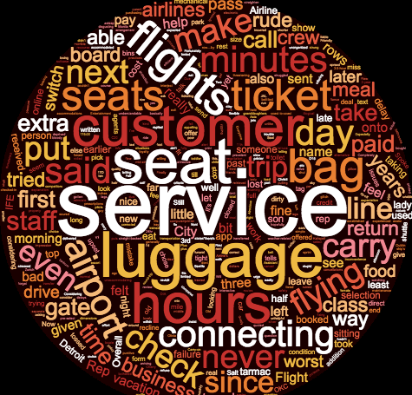
TAKING THE CHALLENGE HEAD-ON FOR the AIRLINE INDUSTRY
What are airline customers talking about?

Slide 6
TOPIC MODELLING: MAKe SENSE OF THE REVIEW DELUGE
Data Gathering
(Scrapy)
Pre-processing
(Pandas, Gensim)
Bigrams,Tokenization
(NLTK, TFIDF)
Data Modeling
(NMF, LDA)
75,000+ reviews

Slide 7


CUSTOMER TALK: the “revEAL”
Delays/Late Arrivals
Inflight Services
Business Class Services
Inflight Seating
Check-in/Baggage services

Slide 8
not enough!

Slide 9
SENTIMENT ANALYSIS: How is the Customer Feeling?
Pre-processed the Data
Tokenized the words
Deep Learning Model : Sentiment Prediction

Slide 10
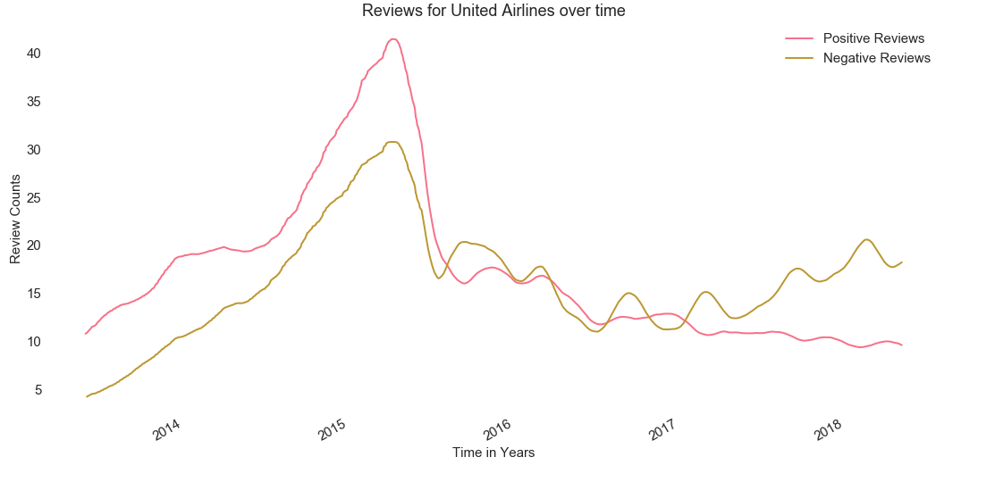
What Questions can I now Answer?

Slide 11
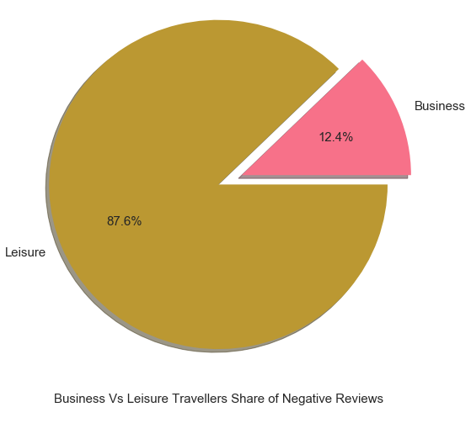
Who are the NEGATIVE reviews coming from?

Slide 12
BUSINESS BENEFITS of MACHINE LEARNING and NLP
Automated review processing: Save Time
Respond Faster: Build Brand Credibility
Better Use of Resources: Save Money
Focussed Efforts: Increase Marketability

